Slide 1


An Energy-Efficient Low-Latency 3D-CNN Accelerator Leveraging Temporal Locality, Full Zero-Skipping, and Hierarchical Load Balance
¹ Changchun Zhou, ¹ Min Liu, ¹ Siyuan Qiu, ² Yifan He, and ¹ Hailong Jiao
¹ VLSI Lab, School of Electronic and Computer Engineering,
Peking University Shenzhen Graduate School, Shenzhen, China
² Reconova Technologies Co., Ltd., Xiamen, China
DEC 5 - 9, 2021
San Francisco, California
http://www.PKU-VLSI.com

Slide 2
I
Introduction
III
Experimental Results
IV
Conclusion
II
The Architecture of the Proposed 3D-CNN Accelerator

Slide 3
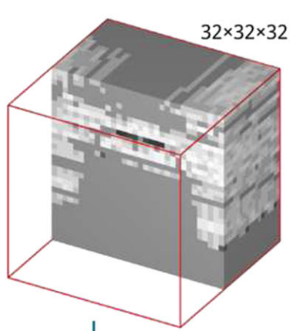
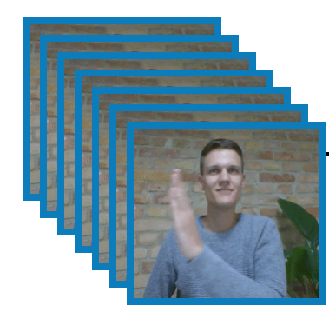
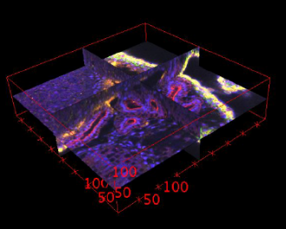
AI in Sequential Images
Video Classification
Gesture Recognition
Medical Image Analysis
3D Object Detection
Sequential Images are Widely Applied
A. Karpathy, G. Toderici, S. Shetty, T. Leung, R. Sukthankar, and F. Li, “Large-scale video classification with convolutional neural networks.” CVPR, 2014.
S. Ji, W. Xu, M. Yang, and K. Yu, “3D convolutional neural networks for human action recognition,” IEEE Transactions on Pattern Analysis and Machine Intelligence, vol. 35, no. 1, pp. 221-231, 2012.
P. Zhang, X. Wang, W. Zhang, and J. Chen, “Learning spatial–spectral–temporal EEG features with recurrent 3D convolutional neural networks for cross-task mental workload assessment,” IEEE Transactions on Neural Systems and Rehabilitation Engineering, vol. 27, no. 1, pp. 31-42, 2019.
D. Maturana, and S. Scherer, “Voxnet: A 3d convolutional neural network for real-time object recognition,” IEEE/RSJ International Conference on Intelligent Robots and Systems (IROS, 2015.

Slide 4
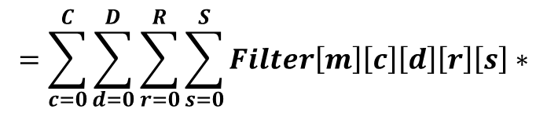
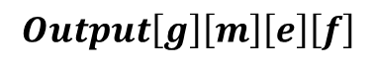
3D Convolution Operation and C3D Network
$$Output\left[g\right]\left[m\right]\left[e\right]\left[f\right]$$
$$=\sum_{c=0}^{C}{\sum_{d=0}^{D}{\sum_{r=0}^{R}{\sum_{s=0}^{S}{Filter\left[m\right]\left[c\right]\left[d\right]\left[r\right]\left[s\right]∗}}}}$$
$$Input[c][g∗stride+d][e∗stride+r][f∗stride+s]$$
D. Tran, L. Bourdev, R. Fergus, L. Torresani, and M. Paluri, “Learning spatiotemporal features with 3D convolutional networks,” ICCV, 2015.

Slide 5
Sparsity and Activation Temporal Locality
Zero-skipping saves storage burden, energy consumption and computation time without accuracy loss
$$T_{diff}= In\left[t+1\right]\left[C\right]\left[H\right]\left[W\right]−In\left[t\right]\left[C\right]\left[H\right]\left[W\right].$$
*C3D @ UCF101, Quantized to 8 bits

Slide 6
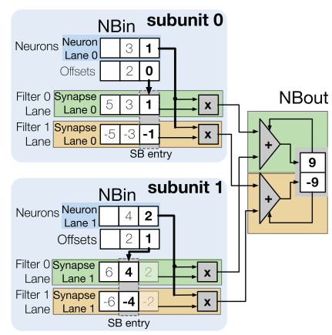
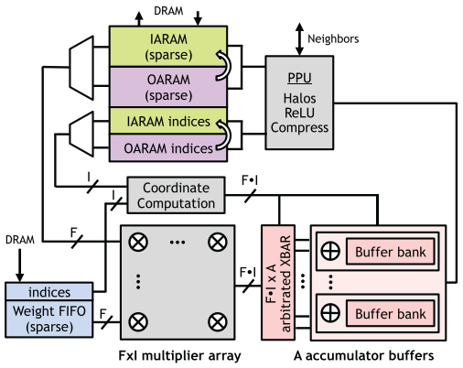
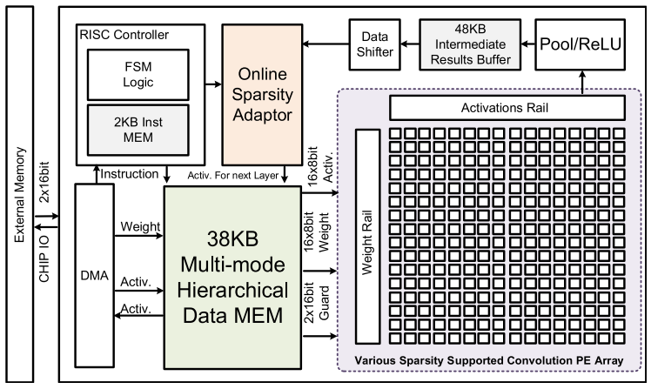
Previous Works on Sparse 2D-CNN
ISCA 2016
Cnvlutin
Gating
SIGARCH Comput. Archit. 2017
SCNN
PT-IS-CP-Sparse Dataflow
VLSI 2018
STICKER
Multi-Sparsity
J. Albericio, P. Judd, T. Hetherington, T. Aamodt, N. E. Jerger, and A. Moshovos, “Cnvlutin: Ineffectual-neuron-free deep neural network computing,” ISCA, 2016.
A. Parashar, M. Rhu, A. Mukkara, A. Puglielli, R. Venkatesan, B. Khailany, J. Emer, S. W. Keckler, and W. J. Dally, “SCNN: An accelerator for compressed-sparse convolutional neural networks,” ACM SIGARCH Comput. Archit. News, vol. 45, no. 2, pp. 27-40, 2017.
Z. Yuan, Y. Liu, J. Yue, Y. Yang, J. Wang, X. Feng, J. Zhao, X. Li, and H. Yang, “STICKER: An energy-efficient multi-sparsity compatible accelerator for convolutional neural networks in 65-nm CMOS,” IEEE Journal of Solid-State Circuits, vol. 55, no. 2, pp. 465-477, 2020.

Slide 7
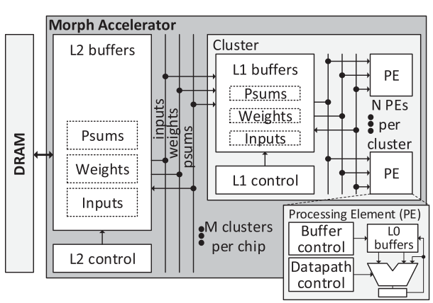
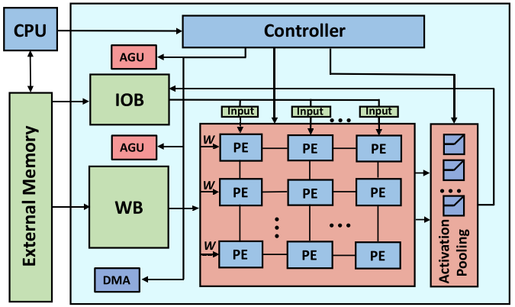
Previous Work on 3D-CNN
MICRO 2019
Morph
Spatial and Temporal Tiling
DAC 2019
Systolic Cube
3D Systolic Cube Architecture
K. Hegde, R. Agrawal, Y. Yao, and C. W. Fletcher, “Morph: Flexible Acceleration for 3D CNN-based Video Understanding,” MICRO, 2018.
Y. Wang, Y. Wang, H. Li, C. Shi, and X. Li, “Systolic cube: A spatial 3D CNN accelerator architecture for low power video analysis,” DAC, 2019.

Slide 8
Contributions of This Work
A threshold-based differential frame sparsity enhancement method is proposed to increase the sparsity of differential frames by dropping out small differential values
To skip both the redundant operations and redundant computation cycles for a wide sparsity range of activations and weights, a full zero-skipping micro-architecture is proposed
To address the load imbalance issue after skipping zeros, a hierarchical load-balancing scheme is proposed

Slide 9
I
Introduction
III
Experimental Results
IV
Conclusion
II
The Architecture of the Proposed 3D-CNN Accelerator

Slide 10
Hardware Architecture
16 PEs in a computation engine
Each PE contains 27 MACs
The scheduler allocates tasks to MACs
The activations are pipelined
The weights are broadcasted
Dynamically allocated SRAM banks
Weight memory
Input feature map memory
Top control and instruction

Slide 11
Computation Flow

Slide 12
Computation Flow
PE calculates the first ifmap using raw data while computing the rest using the temporal differential frames

Slide 13
Computation Flow
The psums are propagated in cascaded fashion with just a single addition per output
The addition propagation from PMEM_2 to PMEM_3 is to restore raw psums

Slide 14
Computation Flow
The raw ofmaps are obtained by ReLU and pooling of PMEM_3’s psums in the POOL module

Slide 15
Why Need Threshold Differential Value Dropout
The differential values in the differential frames
Not sufficiently sparse in the shallow convolution layers
Small values, such as 1 and 2, take a large portion
Meaningless noise does not improve the quality of feature extraction
Drop out small differential values without accuracy loss
R. Yamashita, M. Nishio, R. K. G. Do, and K. Togashi, “Convolutional neural networks: An overview and application in radiology,” Insights into imaging, 2018.

Slide 16
Threshold Differential Value Dropout Results
The amount of activations is significantly larger than the amount of weights in the shallow convolution layers
Dropping out the small differential activation values in the shallow layers could increase the activation sparsity significantly
C3D @ UCF101
Quantized to 8 bits, pruned, and retrained by distiller
Threshold =1

Slide 17
Flag-based Full Zero-skipping
Computation cycles of different methods of zero-skipping
The concept and proposed microarchitecture of full zero-skipping
Y. Chen, T. Krishna, J. S. Emer, and V. Sze, “Eyeriss: An energy-efficient reconfigurable accelerator for deep convolutional neural networks,” ISSCC, 2016.

Slide 18
Flag-based Full Zero-skipping
Computation cycles of different methods of zero-skipping
The concept and proposed microarchitecture of full zero-skipping

Slide 19
Flag-based Full Zero-skipping
Computation cycles of different methods of zero-skipping
The concept and proposed microarchitecture of full zero-skipping

Slide 20
Why Need Hierarchical Load Balancing
The proposed threshold differential value dropout and distiller pruning introduce numerous zero activations and weights, respectively
The proposed full zero-skipping microarchitecture reduces the number of convolution operations dramatically by skipping invalid multiplications
Load imbalance is caused by different sparsity at the same time among MACs and among PEs
V. Gokhale, J. Jin, A. Dundar, B. Martini, and E. Culurciello, “A 240 g-ops/s mobile coprocessor for deep neural networks,” CVPR, 2014.

Slide 21
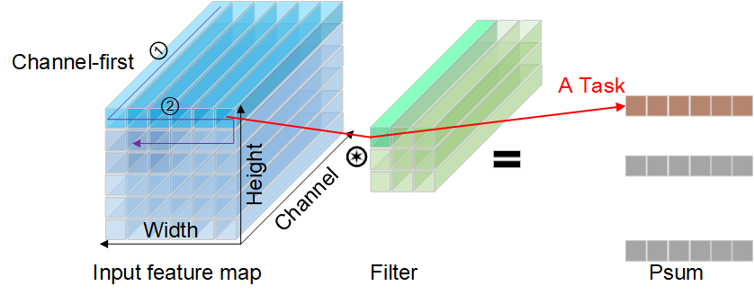
The Computation Flow of the Proposed PE
The computation flow of the proposed PE is similar to weight stationary dataflow
A task is defined as the convolution of a 32-channel weight with a row of 16 32-channel activations

Slide 22
The Intra-PE Load-Balancing
A scheduler is designed to allocate new tasks to idle MACs
Which row of activation, which weight, and which partial sum register file
Low hardware and energy overheads

Slide 23
How The Inter-PE Load-Balancing Works
The 16 PEs share the same activations but perform convolution with different filters
There exists a strong correlation between the sparsity of a filter and the convolution time
Filters are sorted in the descending order of their sparsity
The adjacent filters are divided into groups each of which contains 16 filters
The calculation time is close among the filters in each group

Slide 24
The Inter-PE Load-Balancing Results
The green triangle represents the convolution time savings
Without any hardware overhead due to only adjusting the order of the channels offline
Conv2 layer of C3D with 128 filters
Batch Size = 64

Slide 25
I
Introduction
III
Experimental Results
IV
Conclusion
II
The Architecture of the Proposed 3D-CNN Accelerator

Slide 26
Experiment Setup
Technology: UMC 55nm low-power CMOS
Synthesis
Frequency: 100 MHz
Voltage: 1.08 V
Tool: Cadence Genus
Evaluate the power consumption
TCF (toggle count format) files obtained by Cadence NC-Sim
Benchmark
The 8-bit C3D network pruned, quantized, and retrained by distiller
UCF101 dataset
Distiller, [Online]. Available: https://github.com/IntelLabs/distiller.

Slide 27
The Speedup and Energy Efficiency
The baseline implementation is without proposed techniques
The average sparsity of activation and weight is 68.6% and 85.5%, respectively

Slide 28
Peak Energy Efficiency vs Sparsity
The level of sparsity of activation and weight influences the energy efficiency of the accelerator

Slide 29
Comparison with the State-of-the-Arts
The effective energy efficiency of the proposed work is 4.66 TOPS/W, 13.3× improvement compared with Eyeriss
The speed is also enhanced by 12.2× compared to Eyeriss
Z. Yuan, Y. Yang, J. Yue, R. Liu, X. Feng, Z. Lin, X. Wu, X. Li, H. Yang, and Y. Liu, “A 65nm 24.7 µJ/frame 12.3 mW activation-similarity-aware convolutional neural network video processor using hybrid precision, inter-frame data reuse and mixed-bit-width difference-frame data codec,” ISSCC, 2020.

Slide 30
Comparison with the State-of-the-Arts
· | Eyeriss ISSCC2016 | SCNN ISCA2017 | UNPU ISSCC2019 | TSVA ISCA2019 | STICKER JSSC2020 | ISSCC2020 | This work
Technology | 65 nm | 16 nm | 65 nm | 65 nm | 65 nm | 65 nm | 55 nm
Area [mm²] | 16 | 7.9 | 16 | 22.3 | 12 | 12 | 13.5
SRAM [KB] | 108 | 1200 | 256 | 1024 | 170 | 196 | 225
MAC | 336 | 1024 | 864 (16b) | 4096 | 256 | 64(8b)/128(4b) | 432
Supply Voltage [V] | 0.82-1.17 | - | 0.63-1.1 | - | 0.67-1.0 | 0.51-1.0 | 1.08-1.2
Frequency [MHz] | 100-250 | 1000 | 5-200 | 1000 | 20-200 | 25-100 | 100
Data Type | 16b | 16b | 1-16b | 8b | 8b | 4b/8b | 8b
Performance [GOPS] | 33.4-84 | - | 7372(1b), 1382(4b), 691.2(8b), 345.6(16b) | - | 102-5638 | 12.7-97 | 86.4
Power Consumption [mW] | 94-450 | - | 3.2-297 | - | 20.5-248.4 | 7.3-99 | 86
Energy Efficiency [TOPS/W] | 0.36 (@100 MHz) | - | 1.92 (@200 MHz), 4.71 (@10 MHz) | - | 2.82 (@100 MHz) | 0.33 (@100 MHz) | 4.66 (@100 MHz)
Network Type | AlexNet | AlexNet | VGG-16 | C3D | AlexNet | Mobilenet-27 | C3D
Power Consumption [mW] (100 MHz) | 236 | - | 100 | - | 100 | 99 | 86
Cycles [M] (100 MHz,C3D) | 98.9 | - | - |  | 24.8 | 215.7 | 17.4
* Refer to the paper

Slide 31
I
Introduction
III
Experimental Results
IV
Conclusion
II
The Architecture of the Proposed 3D-CNN Accelerator

Slide 32
Conclusions
An energy-efficient low-latency 3D-CNN accelerator is proposed in this paper by deeply exploiting the sparsity in the neural networks
A threshold differential value dropout method is proposed to increase the sparsity of activations in the shallow convolution layers
A full zero-skipping microarchitecture is proposed to skip both the zero-valued activations and weights for speedup and energy savings
A hierarchical load-balancing scheme is employed to solve the load imbalance among PEs after zero skipping
The proposed accelerator achieves an energy efficiency of 4.66 TOPS/W and a latency of 0.17 s, while running C3D with UCF101 dataset at 100 MHz with 1.08 V supply voltage

Slide 33
Thank you!

